Slide 1
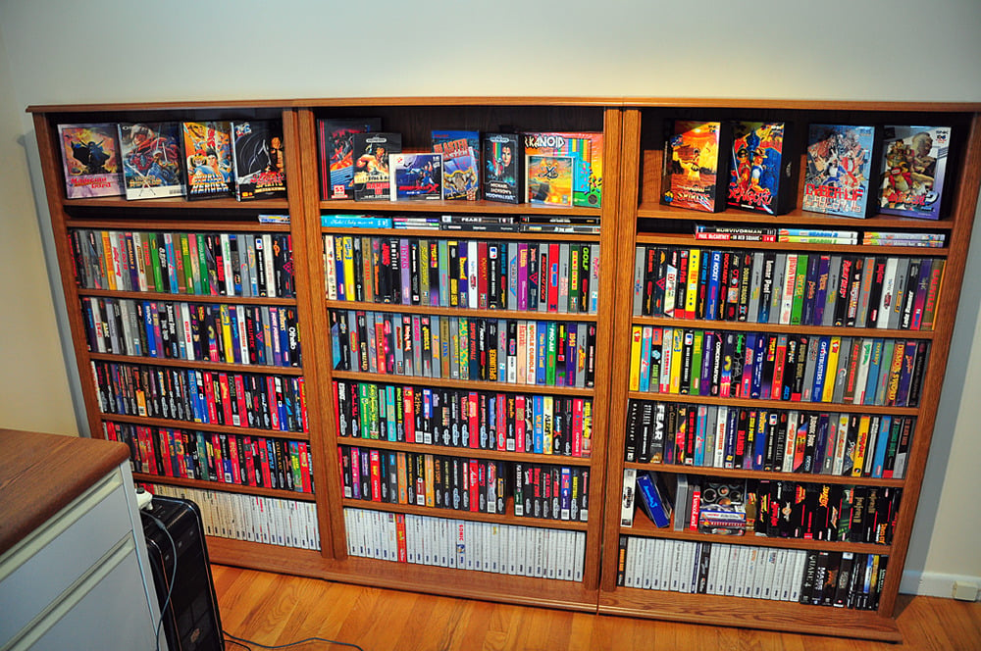
Video Games
Recommendation
System
Presented by
Alex Lopez

Slide 2



Business Case
Ever wanted to pick up a new game but don’t know what to get?
Went to a game store but don’t know what games to consider?
Answer: A Video Game Recommendation System.

Slide 3
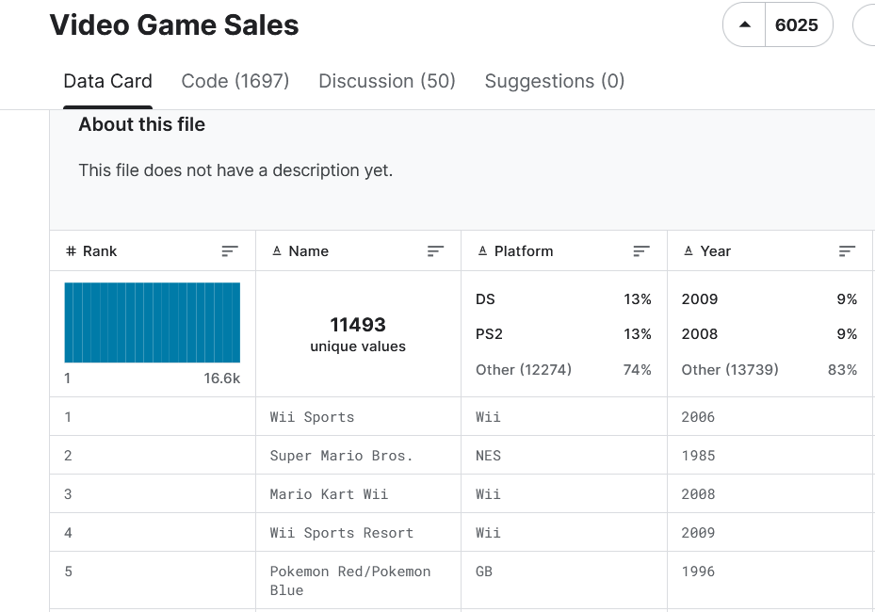
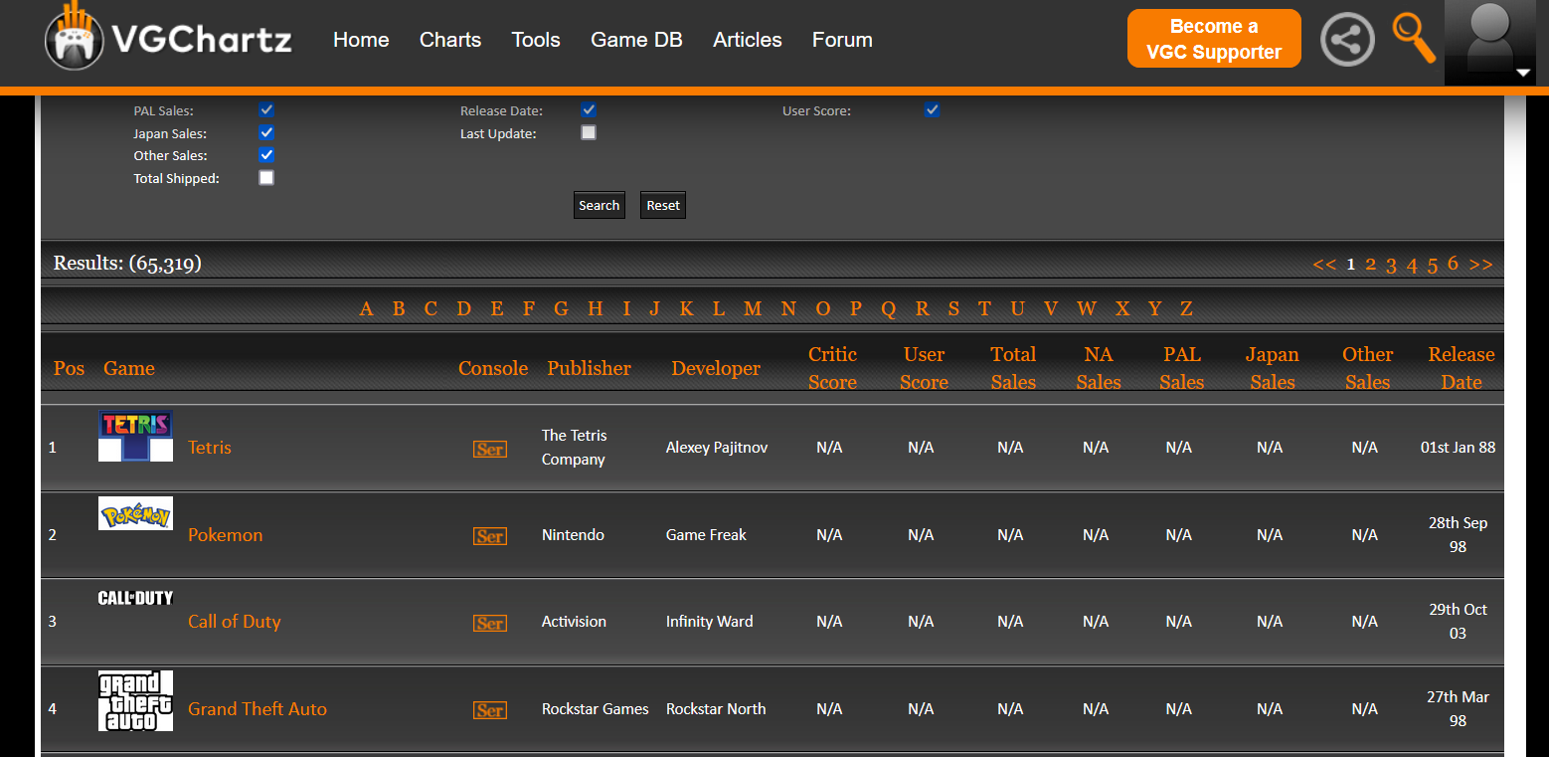
Source of Data
Kaggle Dataset
VGChartz
Link to this dataset https://www.kaggle.com/datasets/gregorut/videogamesales/data:
Scraped data from here: https://www.vgchartz.com/gamedb/
Notes:
Only spend a minute total on this and next two slides

Slide 4

Data Acquisition
Retooled Scraper Provided by author of Kaggle Dataset : https://github.com/GregorUT/
Made Notebook to run scrape python file and made it to save to csv every few results
Set up separate Scraper to get critic/User Scores, then merged with rest of data

Slide 5
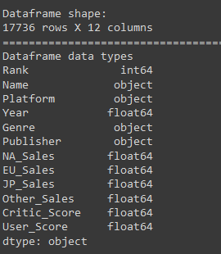
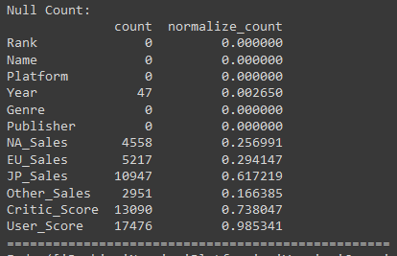
Data Contents

Slide 6

Data Cleaning
Nulls in Years, Publisher, Sales columns (NA, EU, JP, Other), Critic Score, User Score
Drop nulls in Years, Publisher (Unknown -> NaN)
Filled Sales, Critic_Score, and User Score with 0.0
Cleaning out couple of bad data points for Years
Filter out Platforms and Genres that barely show up in the data (threshold = 20)

Slide 7

Feature Engineering
Binning/Aggregation
Publishers into 3 categories: Low. Medium, High Profile
Game entries (multiple releases)
Summed sales data
Averaged out Critic/User Scores (ignoring no scores)
Concatenated Platforms
Encoding:
Label Encode Binned Publishers
One Hot Encoded Genre
Scaling:
Scaled data for Sales columns
& Critic Score/User Scores

Slide 8
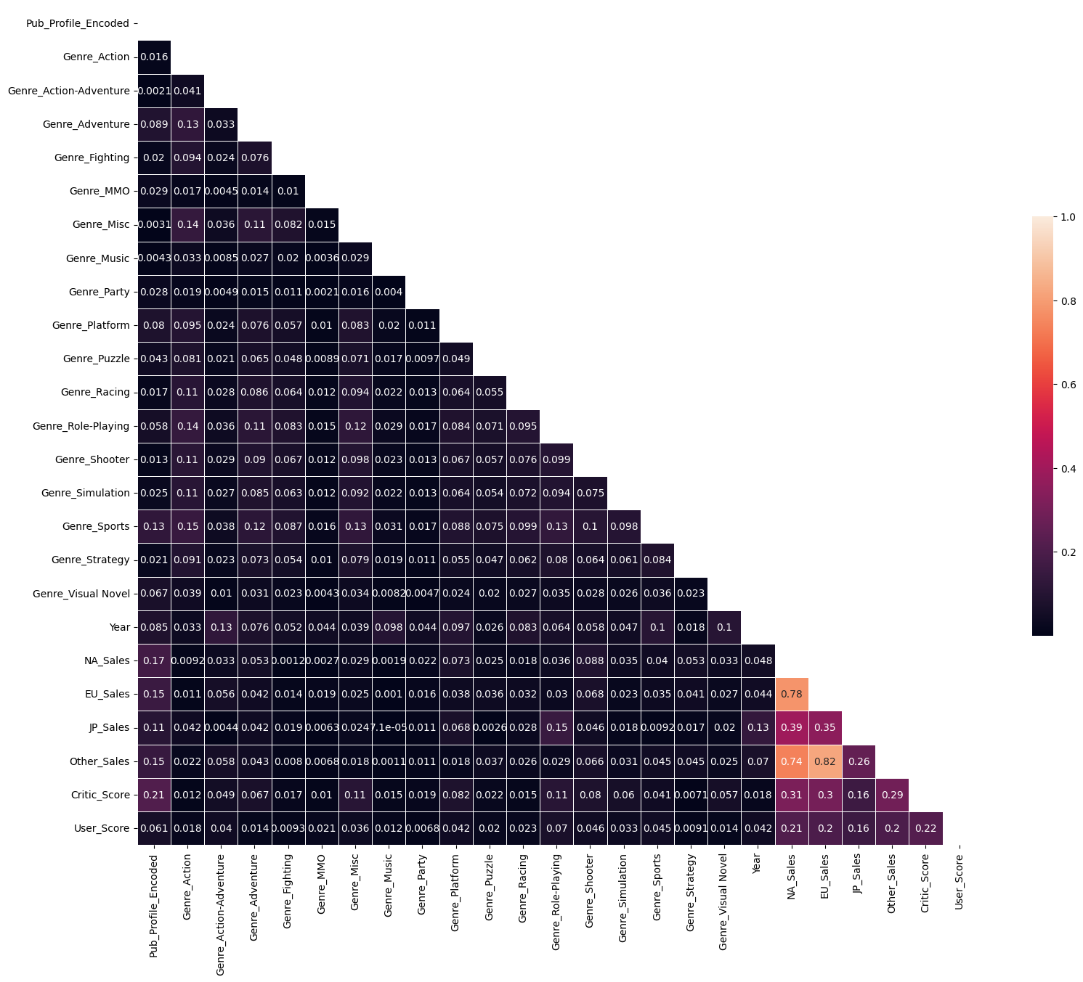
Feature Correlation Map
High correlation between some of Sales Columns
Decided not to drop any of sales since…
Notes:
Quickly get through this too

Slide 9
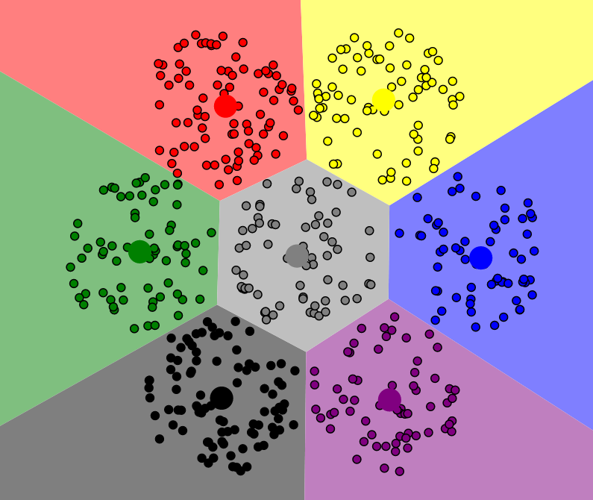
K-Means Clustering
Time to group our data for the Recommendation system

Slide 10
Optimal Hyper Params
Data without User/Critic Scores
43 Clusters
Min_Max Scaler
was slightly worse for MinMaxScaler() with it
~Optimal K-Clusters
Had better inertia/silhouette scores

Slide 11
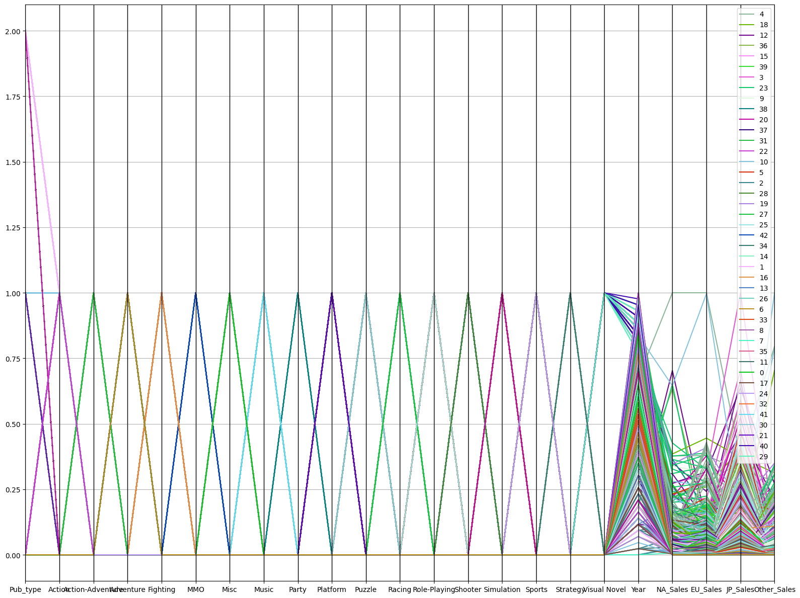
Clusters Visualization

Slide 12

Recommendation System
Time!

Slide 13
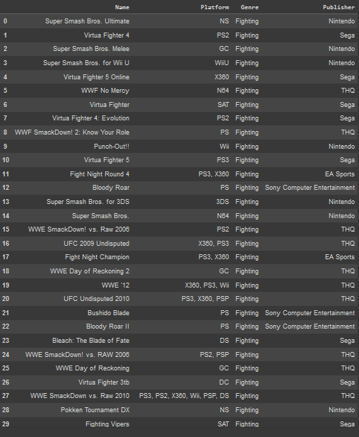
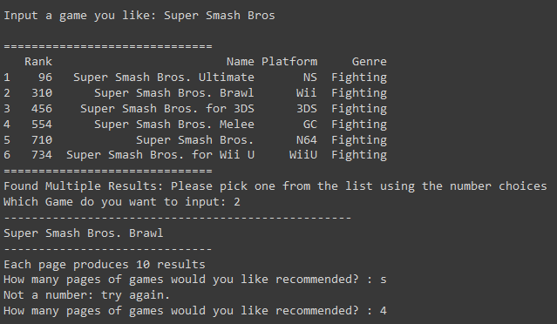
How It Works
Input a game term to look up in K-Means Video Game DB
If it finds nothing; asks for reprompt
If multiple potential entries found, prompt user to pick a specific one
Find cluster group of games the selected game belongs in
Return top recommendations sorted by Critic_Score, User_Score, Rank (Descending for scores, Ascending for Rank)

Slide 14
Demo Time!
Give me a game you want to enter in chat.

Slide 15

Thank YOU!
For attending this presentation
Alex D. Lopez

